Slide 1
Durak Card Game
Made By:
Hanson Yang
Shon Cherniavsky
Oliver D'Avino

Slide 2
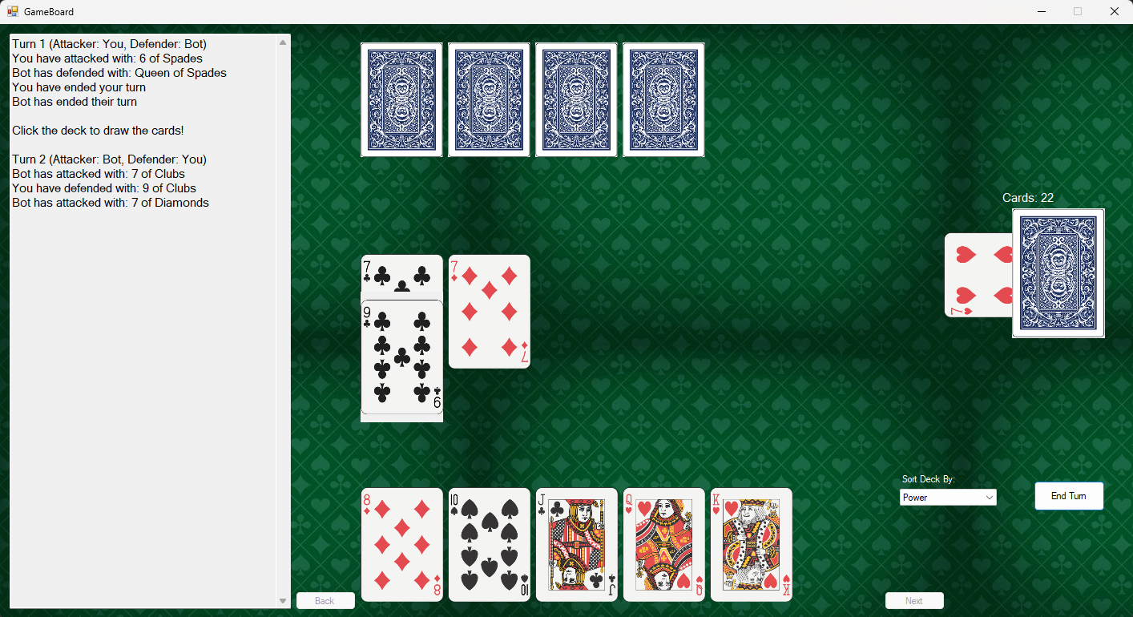

Slide 3
Quick Rules
Turn based card game
Attacker or Defender
Attacker attacks with one card
Defender defends with a better card of the same Suit or Empowered Suit
Back and forth
End of turn:
If defender couldn't defend: Pick up the cards
Or else the cards get discarded

Slide 4
Main Features And Achievements
3 Language Options (English, French, Spanish)
Being able to play against a bot (that plays well)
Being able to use other functionality in the game board while still awaiting for your play (Sorting deck, Switching pages)
Chat History of the turns and card played
Drawing the Decks
Switching pages to see more cards if you have more than 6 cards
Sorting your deck, and keeping the deck in that sorted way
Return to Main Menu when you finish the game and play another Round

Slide 5
Additional Features
Showcasing the Bot's hand to see how many cards he has
Showcasing extra cards of the Bot if any in a label
Showcasing the number of cards in the draw deck
Showcasing the Empowered Suit once the draw deck is gone
Clearing the board when you end your turn
Automatically determines the next attacker and defender after the turn end based on the winner and loser of the turn
Your hand and the Bot's hand gets refreshed in real time when you or the bot plays a card or picks up cards.

Slide 6
Additional Features (cont.)
A small delay before the Bot decides its turn (instead of instant)
When you are hovering over the drawing deck, it's highlighted

Slide 7
Valid/Invalid Input
You can only Press the end turn button once per turn or else it wont do anything even if you press it
You can only defend card if the Bot attacked you
You can only attack once and you need to wait for the Bot to defend before attacking again
You and the bot can only attack 6 times per turn
You can only go to next and previous pages of your hand if you hand has more cards
You can only draw from the deck when the turn ends and you have less than 6 cards

Slide 8
Valid/Invalid Input (cont.)
You can only attack if the attacking card number is on the board (except for the first attack)
You can only defend with a card of same suit (or empowered) and that is stronger

Slide 9
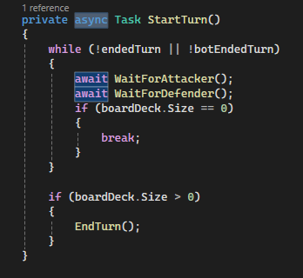
Challenges
Github merging (wasted 2 hours)
Dealing with async and await (wasted 3-4 hours)

Slide 10

DEMO

